Slide 1
Case Study: Internet Banking Platform

Slide 2

Unique Bank
Global Presence: Operates across 28 markets, with a strong base in APAC and EMEA regions.
Regional Focus: Strategically positioned to capitalize shifting focus on emerging markets Asia and ME
Leader in Digital Transformation: Recognized for being forefront of digital transformation in finance sector
Commitment to Sustainability: Actively support social entrepreneur to develop innovative solution for sustainability challenges.

Slide 3
Challenges & Business Goal
Current State Analysis
Current system is legacy-based and built on off-the-shelf products
Customers are happy with the current system, but new features and modern technology are necessary for competitiveness
Goals
Build a new best-in class Retail Internet Banking platform using the latest technologies
Custom software solution replacing the existing commercial product
Focus on delivering a rich user experience and Responsive design, scalable system, and modern navigation
Seamless migration process for existing users

Slide 4
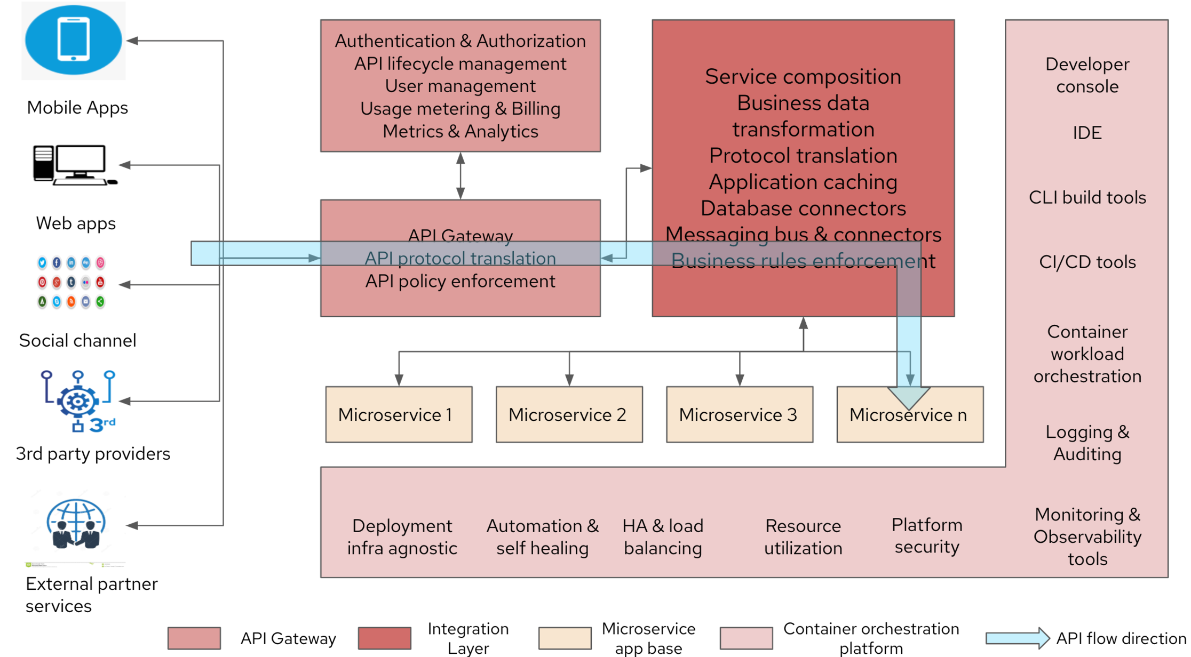

Slide 5




Slide 6
Solution Value Proposition:
Why
How (Our Vision)
Who, When, Where, What
Gain Competitive advantage
Reliable Data driven insights
Trusted partner to support future roadmap
Agile & Flexible Infrastructure
Setup VNet in Azure for DEV, Test, Prod & DR
Monitor and Manage Infrastructure & Apps (Azure Monitor)
ITSM tool integration with Helpdesk (ServiceNow, Azure Service Manager)
ABC Inc as your Trusted Partner to support your envisioned Transformational Roadmap Implementing a Scalable state of the art Web -Portal, Mobile App with Chat Bot hosted in VPC
Implementation to conclude in 12Months and support to run in parallel for 4Y & 9M
Having Integrated Tools across IT Infrastructure, ITSM, Network, Testing, DevSecOps & Monitoring & management
Streamlined Governance, with Ownership and accountability during the Support Phase
Enrich business user experience while accessing Web Portal & Mobile App with No disruption to existing services
Business
Legacy infrastructure with limited flexibility
Limited standardization
Need for new technology adaption
Portal and infra to be able to Scaleup
Enhance User Experience
Design and Implement a Web portal and Mobile App using suggested front & backend technologies for the use cases aligned to Motor insurance LoB
The portal enables Chatbot with Live Agent functionality through GCP native API Mgmt. services
Technology
Need for Integrated User Experience for Stakeholders while accessing Web portals and mobile application
Standardized Data & Improvise Reports
Standardize and Migrate historical data and content to Azure native Data store
Setup Google Analytics Suite to support Web Analytics needs
User
Stable & Secure Operations
Co-creation of SLA's. OLA's & KPI
Simplified Operating model & Governance with Ownership and accountability
24x7 HD & SD for Web-portal & Mobile App support catering to L1/2/3 support
Managed services for Infra & Apps
Cost efficiency challenges
Need for SLA with measures
Need for deduped data to enable reporting
Operation

Slide 7
Azure Kubernetes Service (AKS) for hosting containerized microservices, experience APIs, and integration APIs built on Spring Boot.
Angular App and Drupal CMS on AKS for web applications and content management.
Polyglot persistence using Azure SQL Database (PostgreSQL) / Azure Cosmos DB / Azure Blob Storage for flexible and scalable data storage solutions.
Azure API Management for securing, publishing, and analyzing APIs.
API Management Gateway for internal and external services integration.
Azure Notification Hubs for push notifications.
Azure Service Bus or Event Grid for messaging and integration between microservices.
Azure Cache for Redis for caching data and improving performance.
Azure Key Vault for secrets and key management.
Android MPOS SDK integration with Ezetap, Yes Bank.
Web and mobile app integration with Azure Application Insights for performance monitoring and analytics, and with third-party services like Twitter, Facebook, YouTube.
Azure Monitor and Azure Log Analytics (part of Azure Monitor) for application performance management (APM) and cloud resource monitoring.

Slide 8




Journey 2 value
Current Mode of Operation
Journey 2 Value – I2E2
Future Mode of Operation
Infrastructure built on Legacy Architecture and Standards leading to limited flexibility
Stability issues due to traffic and transactions
Challenges to integrate with external systems
Security & Compliance to adhere to current Global standards
Limited electronic presence and non-persona based web-portal & mobile apps
Interoperability between devices
Initiate
Ideate
Establish
Enable
Agile & Flexible Infrastructure with 24x7 SD & HD support
Enhanced User Experience thru Portal and Mobile App built on Opensource with Chatbot & Live Agent interfaces
Standardized historical data to support Web Analytics & Business needs
Managed Services for Infra & Apps for 478 3M starting from Phase 1 - Go-LIVE
Due diligence & Kick off
Stakeholder Identification
Detailed system study
Validation of list of activities, scope, duration for each activity & guiding principles
Schedule workshop and review & examine AS-IS process documentation
Submission of detailed project plan, deployment plan document and Change Management document
Conduct stakeholder Interviews
Reaffirm Business & functional requirements
Analyse proposed architecture against requirements
Detail SRS Document, USE cases and Activity diagram
Create HLD & LLD for the proposed architecture
Define key integrations points, system requirements and close architectural gaps
Setup VPC in Google Cloud for DEV, Test, Prod, & DR with Active -Active DC & DR replication
Setup Monitoring tools for Infra & Apps
Setup of ITSM and integrate with SD, HD, Monitoring tools and enable workflows
Setup API gateway & BPM tool to manage API's and workflows
Enable Network services to support Migration and implement Security for application
Develop the Web portal using Angular, React, node js, for Motor LoB
Build Chatbot with Live agent functionality and integrated with Portal through API's Setup Google Analytics for Web Analytics reports and Migrate 8GB of Content & 500GB of historical Data to GCP native data store Establish 24x7 HD support and 8x7 SD support for L1/2/3 support for infra &

Slide 9
Human Centric Design Approach (UX)
Human centered research approach providing design that aligns with industry trends. Solution provides best in class user experience within technology framework achieving.
Improved Navigation
Better decision making
Simplified interactions enhancing productivity
Best in class interactions
Consistent UX align with branding standards.
Applying human-centered approach towards design that addresses user needs aligning with industry trends, strategy and prototyping to craft simple, best in class and remarkable digital experience.
Detailed Design & Validation
Assessment Empathy
Gap Analysis
Design conceptualization for dashboard and key flows
Concept Designs
Support
Iterative Prototyping & Validation
Understanding Business and User Needs
Concept sketches for key flows
Detailed wireframes, Visual templates aligning to SMBC standards & Navigation Prototypes
Build Pilot Learn Improve

